Slide 1

Hello
My name is Shaily Kesharwani

Slide 2
Customer Churn Analysis Project
I have made this project that aims to analyze customer churn in a certain business by examining customer usage patterns, customer demographics, and other factors that may influence customer retention.
The main goal is to identify potential opportunities to improve customer retention and reduce churn in the business.

Slide 3
Steps involved in making project
1. Data Acquisition: Acquire the customer or user data, with all the relevant information.
2. Data Pre-processing: Clean, normalize, and transform the data.
3. Exploratory Data Analysis (EDA): Identify patterns, trends, and correlations in the data.
4.Presentation: presented data with creative dashboard that shows all information about dataset.

Slide 4
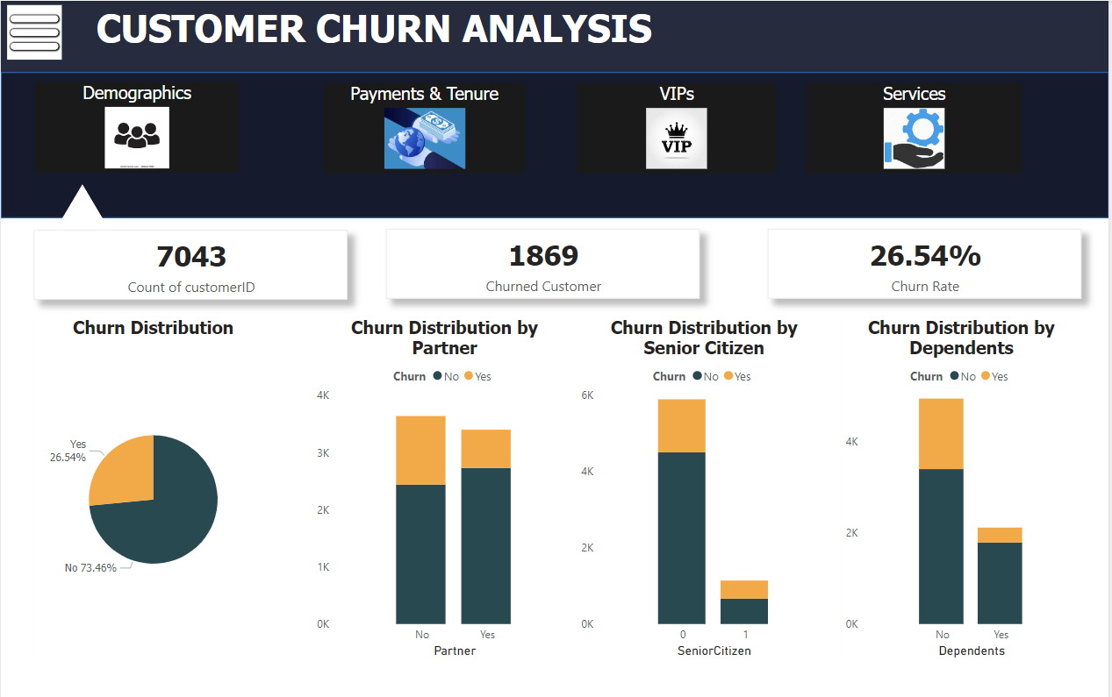
Demographic

Slide 5
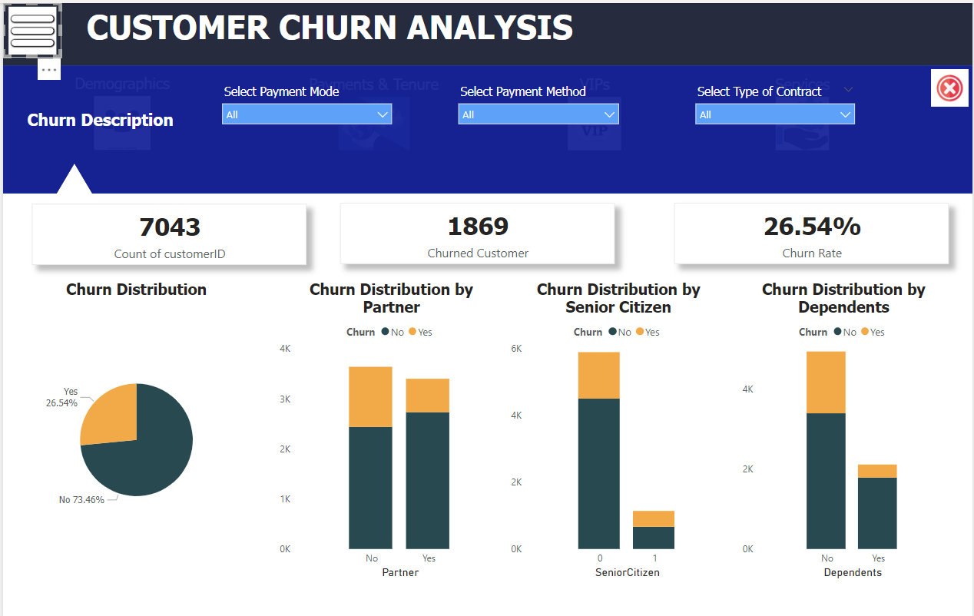
Filters

Slide 6
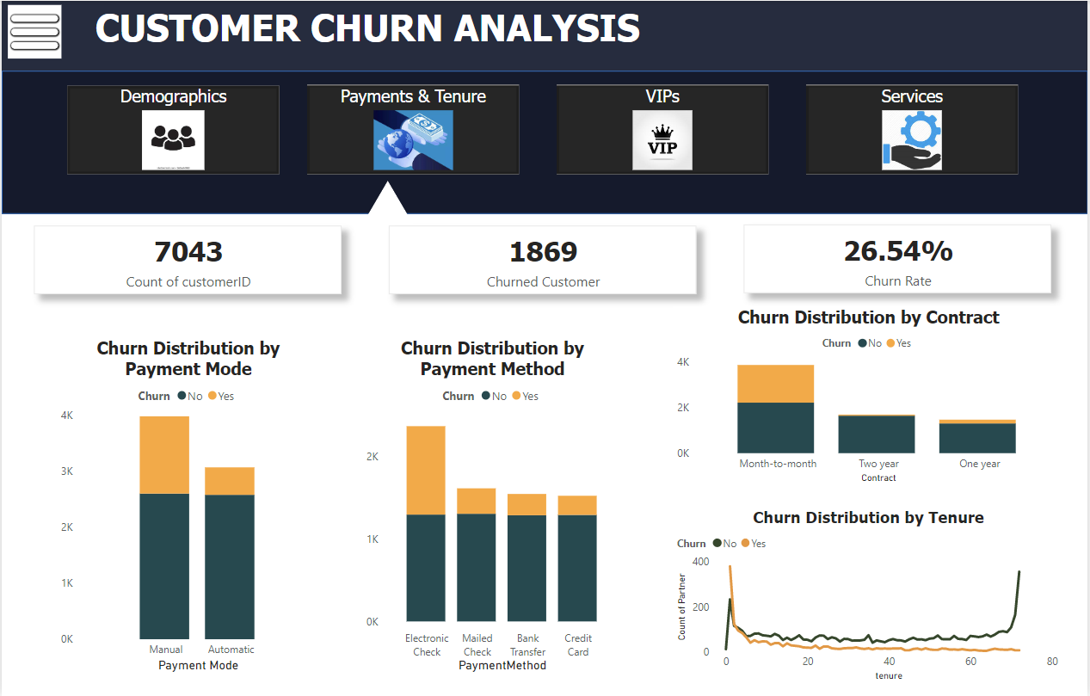
Payments & Tenure

Slide 7
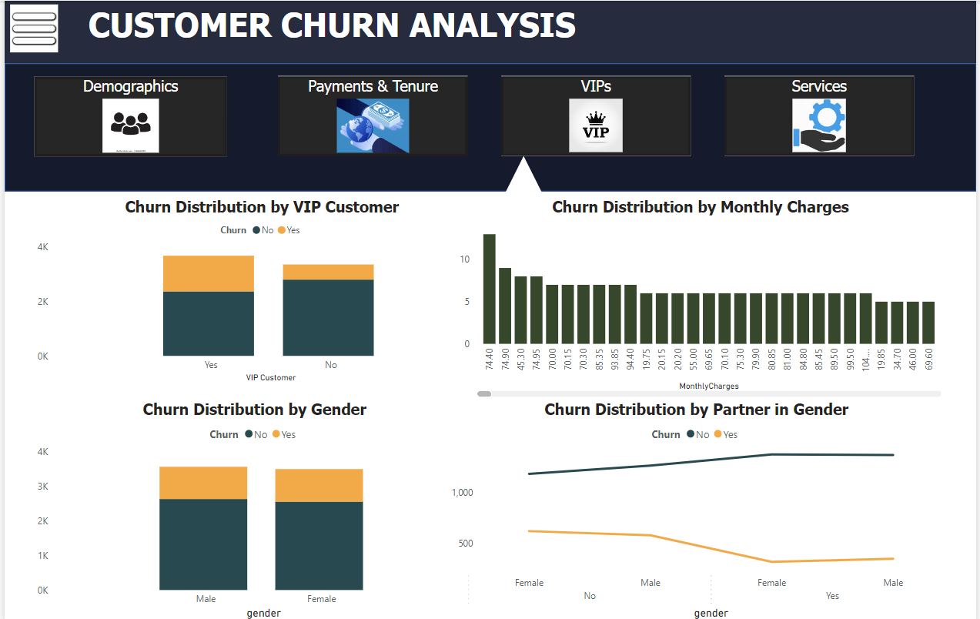
VIPs

Slide 8
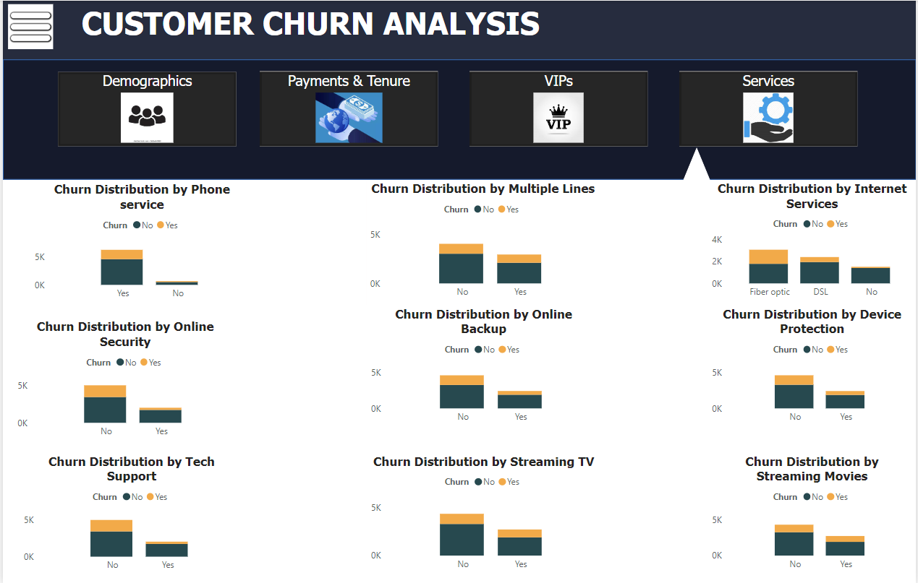
Services

Slide 9
Completion of Project
1. Attractive Dashboard
2. Information about churn customers
3. Demographic Report
4. Payment Report
5. VIP customers
6. Services

Slide 10
Thank You

